Slide 1
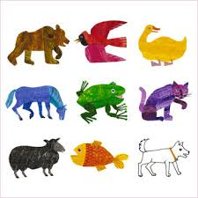
Eric Carle
By Traci Bohlmeyer

Slide 2
About Eric Carle
Born June 25th, 1929 in New York
Moved to Germany when he was 6
Attended school and graduated from a German school
During WWII, Carle was enrolled in the German army and dug trenches on the Siegfried Line
Returned to America in 1952
With only $40

Slide 3
About Eric Carle
Enrolled in the US Army as a mail clerk during the Korean War
After the war he became an art director for an advertisement agency
His first big break
Bill Martin Jr.
Martin noticed a lobster that Carle had drawn for an ad
Asked Carle to illustrate his book “Brown Bear, Brown Bear, What do you see?”

Slide 4
About His Books
Next I will be showing you a list of books
I will give you a brief overview of the book
I will rank the book 1-5
1- least likely to teach with
5- most likely to teach with

Slide 6
1,2,3 to the Zoo
His first book,1968
Each car on the train has one more zoo animal than the one before, from the first car with an elephant to the last with ten birds.
Rank- 4

Slide 7
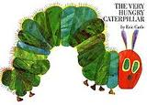

Slide 8
The Very Hungry Caterpillar
1969
Most famous book
This book shows the stages of a butterfly and also days of the week
Rank-5

Slide 10
Pancakes, Pancakes!
1970
Jack wants some pancakes, but first he must gather eggs from the chickens, wheat from the farmer, flour from the miller, milk from the cow, etc. His mother shows him how to cook and flip them, and hungry Jack knows what to do with them next.
Rank-3

Slide 12
Do You Want To Be My Friend?
1971
A simple story on the universal theme of friendship.
Rank-4

Slide 14
Rooster’s Off to See the World
1972
One morning, a rooster sets off to see the world. Soon he's joined by two cats, then three frogs, then four turtles, then five fish. But one by one, his friends return home and leave Rooster alone.
Ranking-4

Slide 15
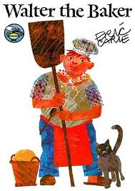

Slide 16
Walter the Baker
1972
Carle retells the legend of how the pretzel was made. By order of the Duke, Walter the baker must invent a tasty roll through which the rising sun can shine three times.
Rank-2

Slide 18
Have you seen my cat?
1973
A boy’s pet cat has disappeared and he goes to look for it. While looking, the boy comes across many different types of cats.
Rank-3

Slide 19
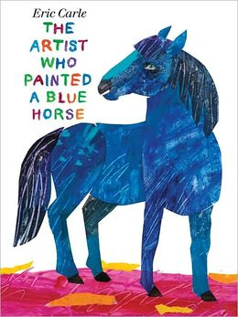

Slide 20
The Artist Who Painted a Blue Horse
2011
The artist in this book paints the world as he sees it, just like a child. There's a red crocodile, an orange elephant, a purple fox and a polka-dotted donkey. Very Imaginative
Rank-4

Slide 22
Mister Seahorse
2004
After Mrs. Seahorse lays her eggs on Mr. Seahorse's belly, he drifts through the water, greeting other fish fathers who are taking care of their eggs.
Rank-4

Slide 24
The Very Busy Spider
1984
Various farm animals try to distract a busy spider from spinning her web, but she continues and produces a beautiful web.
Rank-3

Slide 25
Activity 1-The Very Hungry Caterpillar
STORY SEQUENCE: Provide a long piece of yarn, a hole punch, and patterns of the different foods (apple, pear, plum, strawberry, orange, piece of chocolate cake etc…) which appear in this story. Students will color, cut, and punch a hole in each food. Then they may sequence the story by putting the food on the string as they appear in the story. You may want to have your students do this while you read the story for the second time or you may wish for your students to try this after you have read the story.

Slide 26
Activity 2- Have You Seen My Cat?
Put the students into groups and assign each group a different type of cat
Have the studies do a research project on their cat
Habitats, diets, where they live, families
Have the groups present to the whole class
Can do this as a reporter, webquest, poster, etc.

Slide 27
Activity 3- Do You Want to be my Friend?
Read the story and talk about what makes a good friend
Have the students write about what the characteristics of friends are to them
Have them make a wordle using words from magazines to make a collage from words that describe their friends

Slide 28
Activity 4- Mister Seahorse
Read the book
Talk about the different animals hiding throughout the story
Go back through the story and talk about how the animals hid. What helped the trumpet fish to hide in the reeds? (shape, color)How about the lionfish? (shape and color) the leaf fish? Why does the stonefish have that name? (it looks like a rock) How did all of these animals hide?
Also talk about other animals like the chamelon (could use Carle’s book) and how they blend in also.
Have the students create their own scenery using tissue paper and glue and have them try to hide an animal
Carle also does a lot of his illustrations with tissue paper

Slide 29
Bibliography
Beneduce, A. (2003). Eric Carle. Horn Book Magazine, 79(4), 425-428.
Brodie, C. S. (2004). The Very Talented Artist: Eric Carle. School Library Media Activities Monthly, 20(10), 41-43.
www.barnesandnoble.com
http://www.eric-carle.com/ECbooks.html
http://www.teachingheart.net/veryhungrycaterpillar.html
http://www.jennyjvalentine.com/TESOL%20Overview/Calla%20Group%20Unit%20Plan%20Literature.pdf

